Slide 1
Java on AWS Long Island Java Meetup July2018
Larry Diamond
https://github.com/larrydiamond/

Slide 2
Spring Boot for RESTful services
Opinionated, but well supported and ready to go
https://start.spring.io - make your own app now
They probably have a jar to make whatever you’re doing easier with less source code
Code Sample

Slide 3
S3 storage
S3 cost is 1/10th the cost of EFS (current pricing)
S3 and EFS can be used by multiple EC2s at once, EBS can only be used by one EC2.
Glacier and Infrequent Access Storage can further cut costs for S3
Not a file system, need to use their API
Use AWS Config or AWS Secrets Manager for passwords
Code Sample

Slide 4
RDS & Aurora
MySQL, MS-SQL, Oracle, PostreSQL
Easier to backup, replicate, and secure
No special API, no code sample

Slide 5
Email & SMS
SNS (Simple Notification Service) supports both
Simple Custom API for SMS
Phone Number Validation
Just in case there’s a would be spammer here there’s no code sample

Slide 6
How to deploy? Lambda, Fargate, or Beanstalk?
Do you also need other apps along with your service on the same machine?
Fargate
YES
Lambda
Can your service start in 100-300 ms?
YES
NO
Beanstalk
NO

Slide 7
Try to deploy to Lambda
Cheaper than keeping instances up 24x7 (even with auto scaling)
Break up Docker deployments into separate Lambdas or integrate with AWS services
Keep JVM start up low (Lazy load what you can)
Use Cloudfront to host static files to keep the load off

Slide 8
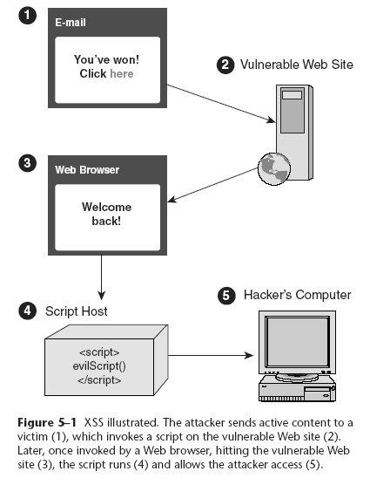

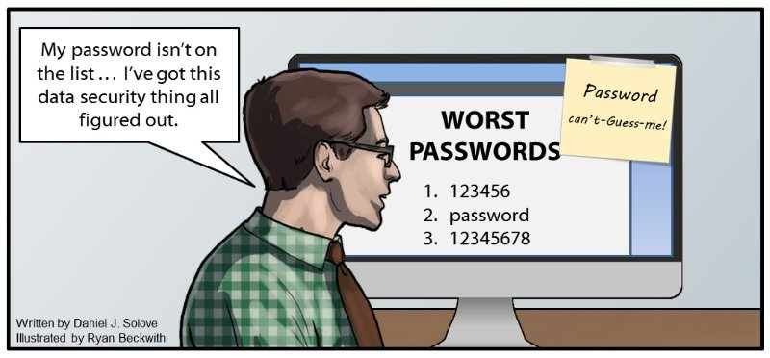
Security
WAF – Web Application Firewall
Reduces SQL Injection
Reduces Cross Site Scripting
Shield – Reduces DDOS
There are lots of exploits it cant stop
OWASP 2017

Slide 9
Thank you!
Larry Diamond
https://github.com/larrydiamond/
Abed Ali will be presenting next and getting into much more depth on AWS Rekognition!

